Slide 1
USB Security Key
Group Members
Manojkumar Patil - 315CS20012
Vinayak Kamkar - 315CS20048
Vishal Kadalagi - 315CS20049

Slide 2
TABLE OF CONTENTS
01
02
03
04
Introduction
07
Technology
Scope
08
System Architecture
Work & Cost Breakdown Structure
Design & Implementation
09
Time-Line Schedule
10
Features & Functionality
05
11
Risk Analysis & Methodology
Conclusion
06
Literature Survey

Slide 3
Introduction
A USB security key is a small device that you can plug into your computer to make sure only authorized person can access certain things. It works like a special key that you need to have physically with you. When you plug it in, it proves to the software that it's really you trying to get in. This makes it harder for someone else to pretend to be you or hack into your software. It's like having a secret key that only you have, and it helps keep your software safe.

Slide 4




SCOPE
Encryption
&
Decryption
Authentication
User
Experience
Integration

Slide 5
WORK BREAKDOWN STRUCTURE
01
02
Project Planning & Requirement Gathering
Research & Evaluation
03
04
Design & Development
Implementation & Testing
05
Maintainance

Slide 6
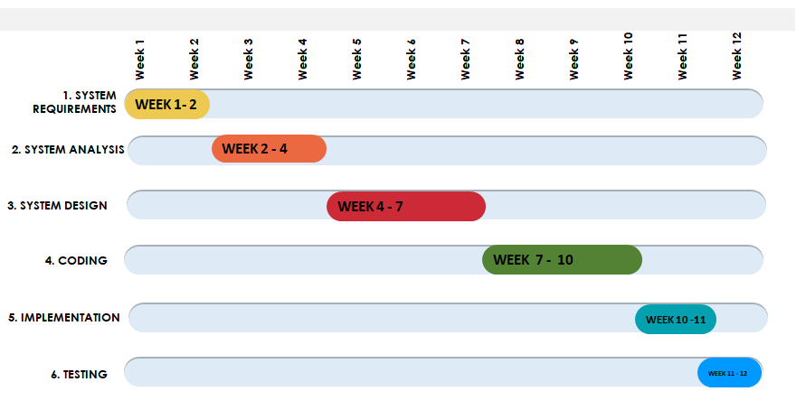
TIME-LINE SCHEDULE

Slide 7
COST-BREAKDOWN STRUCTURE
EFFORT = a(KLOC)^b
KLOC = 1.1
TIME = c(EFFORT)^d
For Organic Project a, b, c, d Values are as follows :
a = 2.4
b = 1.05
c = 2.5
d = 0.38
Estimated Man Power Cost Per Month is Rs.500

Slide 8
COST CALCULATION
EFFORT = a(KLOC)^b
EFFORT = 2.4(1.1)^1.05 = 2.65
TIME = c(EFFORT)^d
TIME = 2.5(2.65)^0.38 = 3.6
COST = Cost per month * Man power * Time * Efforts
COST = 500 * 3 * 3.6 * 2.65 = Rs. 14,310

Slide 9
RISK ANALYSIS
Physical Security
Compatibility
Hacking
Physical Security measures such as locking cabinets or secure keychains could be implemented.
The Key should be tested with various devices, and Compatibility issues should be resolved before deployment.
Strong Encryption methods could be used and the key should be regularly updated with the latest security patches.

Slide 10
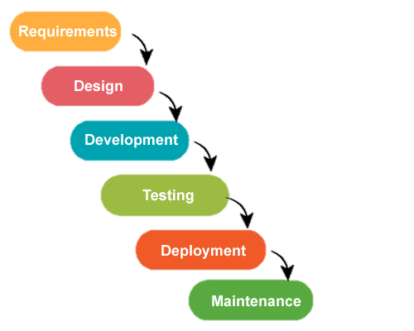
METHODOLOGY
Waterfall Model
The Waterfall Model is a sequential project
management approach where each phase is completed before moving to the next, ensuring a linear flow of development activities

Slide 11
Literature Survey
D.P.McKay (2020)
K. Ahuja (2021)
“Using a USB Security Key for Two-factor Authentication with SSH”
This article explains how to use a USB Security Key for two-factor Authentication with SSH, a widly used secure shell protocol.
“USB Security Key : Your First Line of Defense Against Cybercrime”
This article provides an overview of USB Security Keys and their benefits for protecting CyberCrime.

Slide 12
Technology
USB Connector
NON-Volatile Memory
Cryptographic Protocols
This is used to connect USB Security Key to a Computer
It is a Flash Memory, it is used to store Security Keys and other Authentication Data
These are used
to ensure the
Security

Slide 13



System Architecture
Components
1. USB Drive 2. Client PC

Slide 14
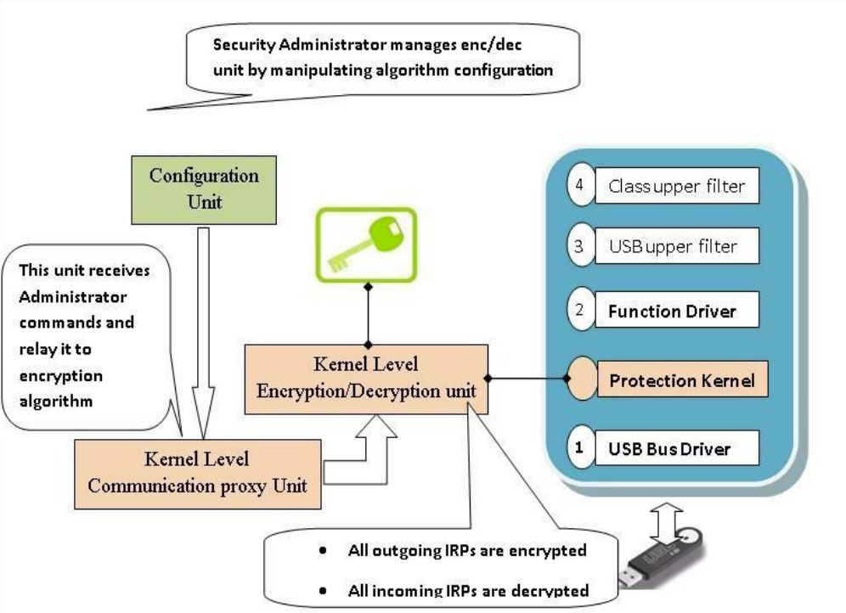
Diagram

Slide 15
Design & Implementation
1. Design :
Here we have used background images, photos, mp4 file videos, texts and labels etc….
2. Implementation :
>> Languages
75%
25%
Python
(Coding)
MySQL
(Database)
75%
Notes:
Python

Slide 16
Features / Functionality
Two-Factor Authentication
Secure Login
Hardware-based Security
Passwordless Authentication
Data Encryption / Decryption
Physical Durability

Slide 17
CONCLUSION
We have designed and manufactured a reliable and secure USB security key, ensuring its compatibility with various systems. Users can now benefit from enhanced security and convenient authentication with the deployment of these USB security keys.

Slide 18

THANK YOU...!
we = Persons( )
while(we.awake( ))
we.code( )

